Slide 1
Little Lemon London Web development

Slide 2
Introdução
This is the capstone project for the Meta Front-End Developer Certificate which expects the following:
Figma design,
Responsive website layout,
“book a table” form component
Application of web development best practices,
Use of React.js and other libraries and frameworks

Slide 3
Kin Cunico
This presentation will include Javascript, HTML5, CSS3, React.js, Next.js, and Chakra.ui.
This presentation aims to showcase the correct and efficient use of web development principles.

Slide 4
Timeline
The timelife for this project followed the next structure:
Project Overview | Figma Design | Landing Page Design | Booking Form Design | Test creation and automation | Hosting and user testing
04/22 | 04/22 | 05/2022 | 05/2022 | 05/2022 | 05/2022
This step included the requested project overview, understanding the clients requests and expectations. | Here is the initial Figma wireframe, with the low-fidelity wireframe, and followed by the high-fidelity wireframe. | The landing page design using Javascript with React.js, and CSS3 modules. | Book a table form design using Javascript with Formik, and Chakra.ui. | Set up of automated tests to verify the correct behaviour of form components using Jest. | Web hosting of the project and project delivery after user testing.

Slide 5
Project Overview
The owners of Little Lemon learn that their customers are frustrated, that they can't easily reserve a table on their website. They want to resolve this issue so that they can plan staff and supplies, not solely rely on walk-ins, and give their diners a great experience.
Create a form for the website for customer to be able to book a table in their restaurant.
The form must have validation.
Customers may only be able to book a table if it is available for their selected day.
About section
Highlights and Specials section
Descriptions and photos of dishes
Navbar
Footer
Testimonials section

Slide 6
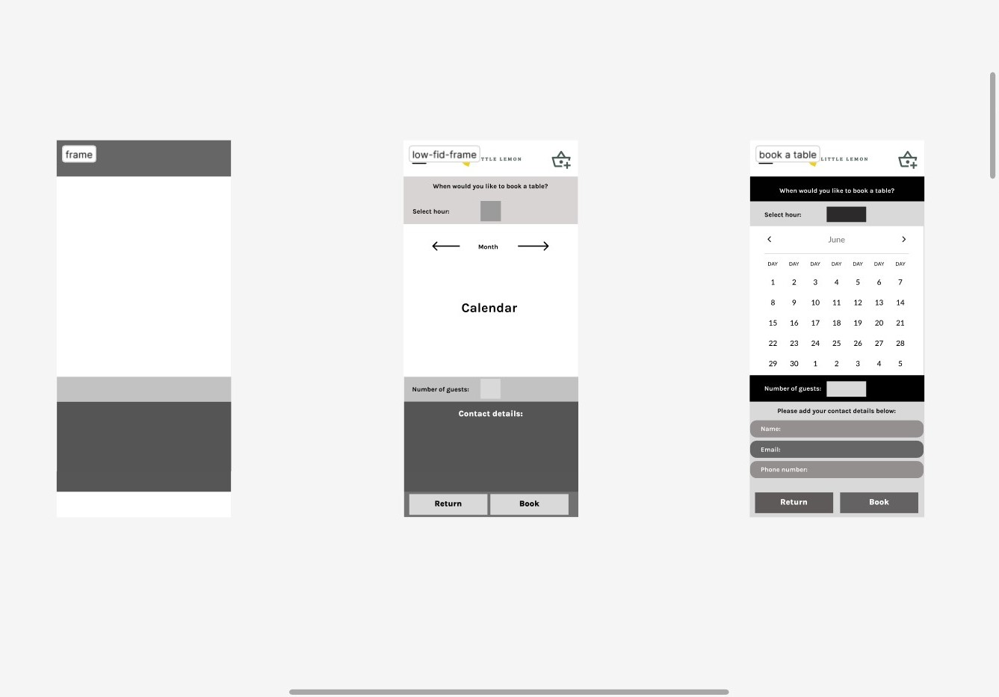
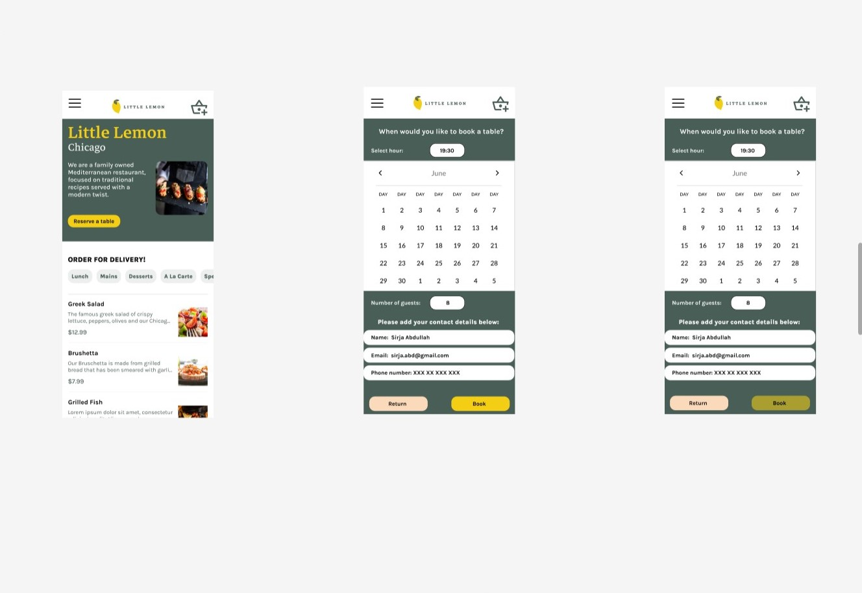
Figma design
From wireframe to final design:

Slide 7
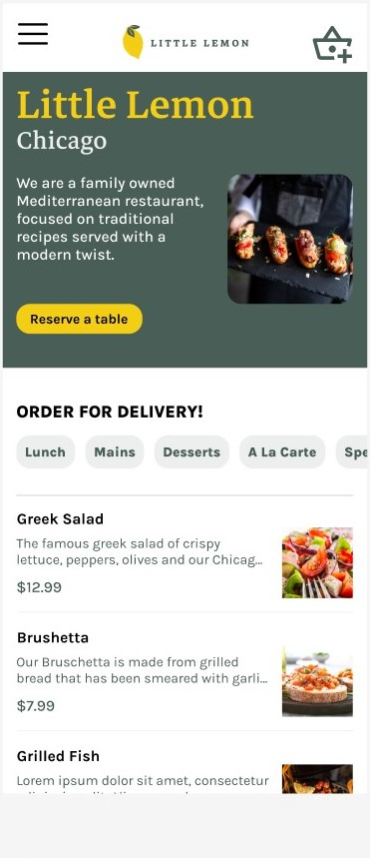
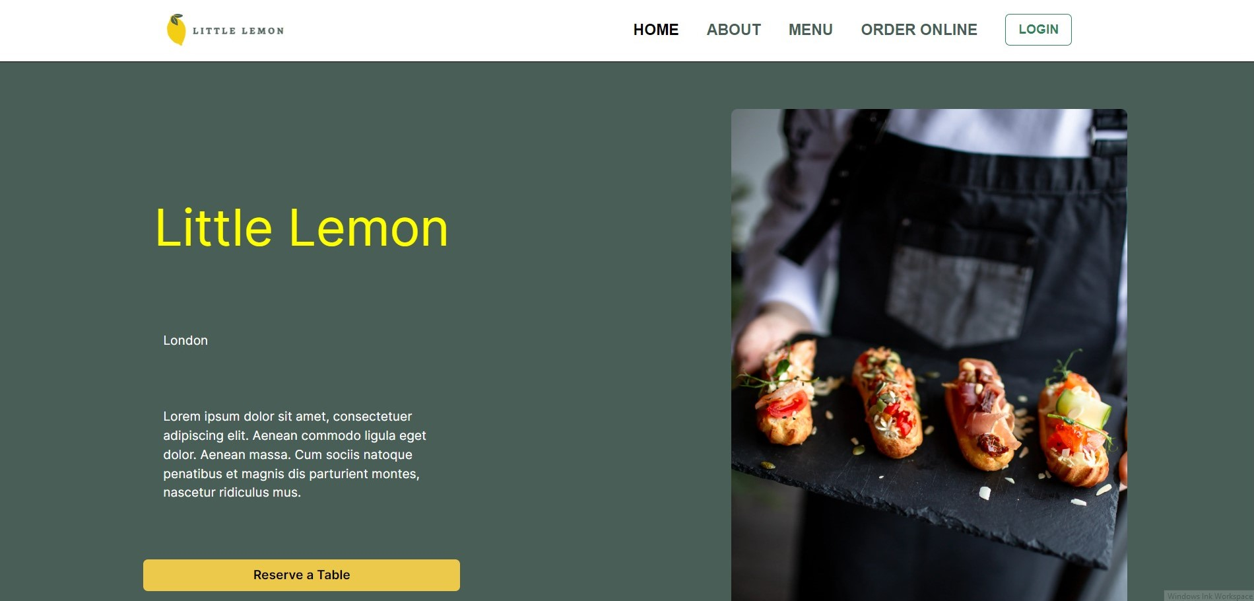
Landing Page

Slide 8
Como celebrar
Liste algumas formas de celebrar o Mês do Orgulho LGBTQIA+. Eis alguns exemplos:
Descubra artistas LGBTQIA+
Leia livros de autores LGBTQIA+
Ouça músicos LGBTQIA+
Saiba mais sobre a história LGBTQIA+

Slide 9
Conclusão
Forneça um breve resumo da sua apresentação. Lembre a audiência sobre o que abordou nos diapositivos anteriores.

Slide 10
Unit Testing
Testing aiming at testing the following components:
Form validation
Form Submission
After form submission pop-up page
describe("Table Booking Form", () => {
test("submission is disabled if all required fields are not filled", () => {
const handleSubmit = jest.fn();
render(<TableBooking onSubmit={handleSubmit} />);
const name = screen.getByTestId("name");
fireEvent.change(name, { target: { value: "k" } });
const submitButton = screen.getByTestId("btn");
fireEvent.click(submitButton);
expect(handleSubmit).not.toHaveBeenCalled();
expect(submitButton).toHaveAttribute("disabled");
});
});

Slide 11
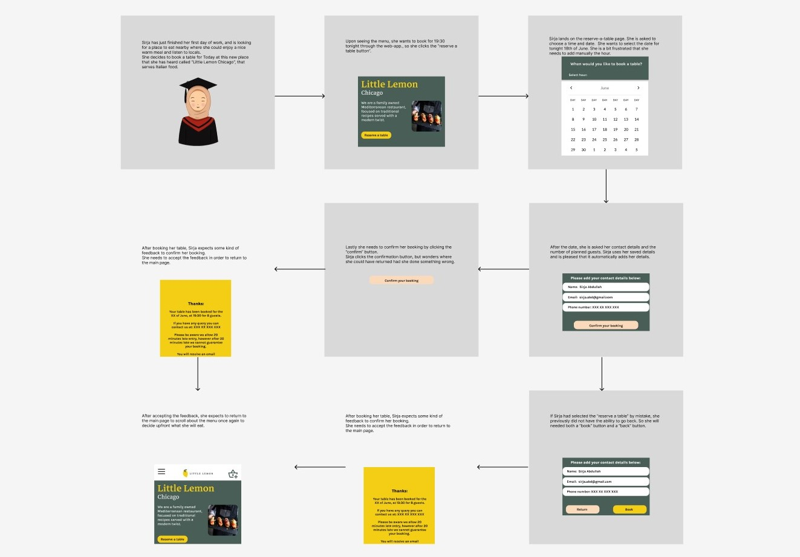
User testing & project delivery

